Slide 1
Computer Fundamentals
How does a calcuator help us?
Data & Information – Lesson 2

Slide 2
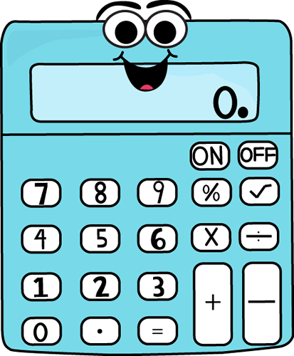
What does the calculator give?

Slide 3
Study the following simple sum
6 + 4 = 10
Pair up, identify/guess the following:
Input
Output
Data
Information
Instructions

Slide 4
Have U decided on each answer?
Thank you for guessing!
Now compare your answers with the answers on the next slide.

Slide 5
How does Data →Information
Output
Input
6 + 4
= 10
6 + 4 =
data
instruction
information
Information = processed data

Slide 6
If we have many such sums?
If we have many sums to add...
Can a calculator or machine do the sums by itself?
If we just give the pairs of numbers, e.g.
6 & 4, 7 & 5, 13 & 15, 34 & 42, etc.
How?

Slide 7
Idea cards:
What do you need to do to get a machine to follow instructions?
Pair up, discuss with your partner
On VIPP cards or paper write your ideas using keywords or phrases – one idea per card

Slide 8
Group ideas on cards:
What are the main things that need to be done to allow a machine to follow instructions?
Write FOUR main ideas below:
1. 2.
3. 4.

Slide 9
Memory or storage
Before a machine can follow instructions...
It needs to store the numbers in a memory just like M of a calculator...
Lets therefore imagine that we have three memories like a calculator...
M1, M2 and M3
6→M1, 4→M2, ? →M3

Slide 10
Group Presentations
Class to break up into four groups.
Each group to design instructions for a machine to add any two numbers.
Each group to put their instructions on a poster and explain to the rest of the class.

Slide 11
How will a machine understand?
How will a machine understand the instructions you are giving?
It needs something like a dictionary.
You also need to know the words that are in the dictionary.
The dictionary we are going to use is called QBASIC.

Slide 12
QBASIC has:
The following commands which you can use to input into memory and output from memory
INPUT M1
INPUT M2
M3 = M1 + M2
PRINT M3

Slide 13
In the lab:
Try the program out in the QBASIC dictionary.
Find the folder labYMI
In it find QBASIC folder
Find QB.exe
Load QB
Write and run program
Change the formula, try again.

Slide 14
Answer Q for next class
In your textbook, find the chapter on Interpretors and Compilors – find out the role of each. Why did the teacher call these things dictionaries?

